Slide 1
Nuclear Spin Physics via
Polarization Measurements
Tomotsugu Wakasa
Department of Physics, Kyushu University

Slide 2
Contents
Three-nucleon force effects in few body systems
  Clear signature of three nucleon forces
  Defects in spin-dependence
Pionic correlations in spin and isospin responses
  Precursor of pion condensation
  Short-range tensor correlation effects
Gamow-Teller and Spin-Dipole Strengths
  Tensor force effects
  Information on 2β-decay matrix elements
Emphasis on recent experimental data from RCNP, RIKEN, and KVI
(Mainly polarization observables)

Slide 3
Three Nucleon Force Effects in Few Body Systems

Slide 4
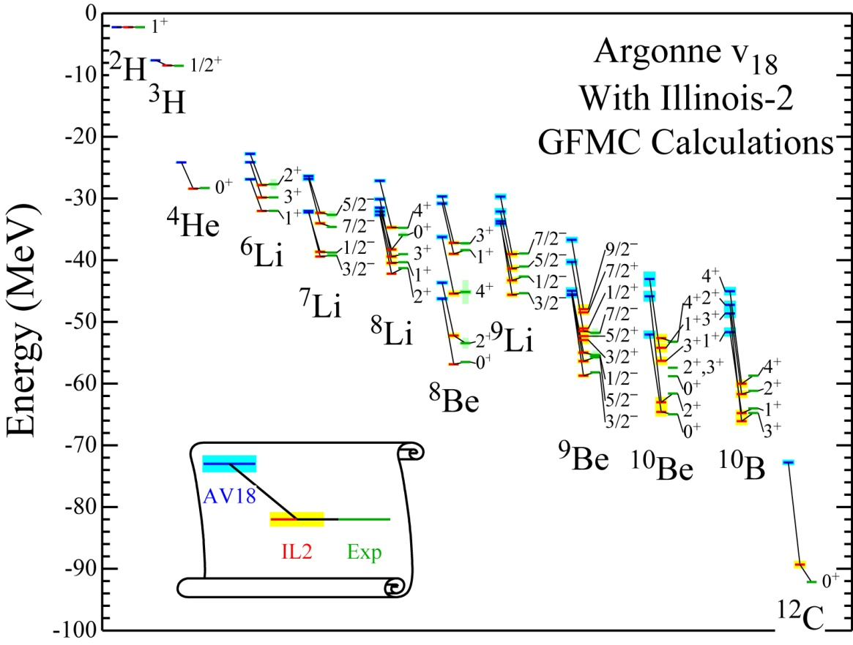
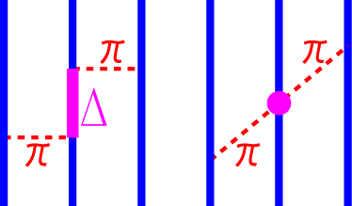
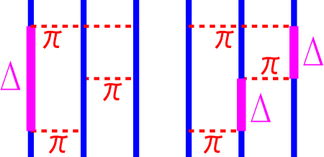
Many Nucleon Force － 3NF －
S.C.Pieper et al., PRC 64,014001(2001).
First indication of 3 NF
  Binding energies
  of ³H and ³He
    Smaller than exp.
    by 0.5ー1 MeV
  Need 2π-exch. 3NF
    TM99, Urbana IX, etc.
Further indications
  B.E. and E_{x} for A≦10
    Green’s func. MC
    No-core shell model
  Need 2π-exch. 3NF
  Also need 3π-exch. 3NF
    Illinois 2, etc.
2π-exch. 3NF
3π-exch. 3NF

Slide 5
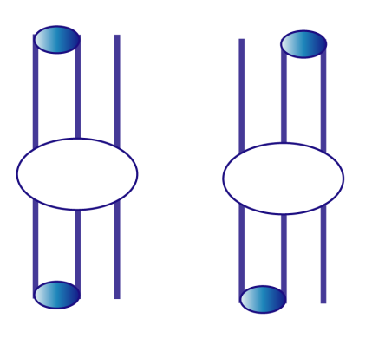
3NF Effects in Scattering States
At intermediate
energies
At low energies
Dynamic properties of 3NF
    Energy- and momentum dependence
    Spin-dependence
  Difficult to access by static properties (Ex. etc.)
  Can be accessed by reaction data
3NF effects are expected to be small
  Much smaller than 2NF
  Easily masked
3NF effects in N-d elastic scattering
  2NF contributions become minimum at θ～120°
  2NF contributions become small
  with increasing energy
  3NF contributions are less sensitive to energy and θ
3NF effects
will appear
NN
Direct
NN
dσ/dω
Exch.
3NF
0°
θ
180°
Direct
Exch.
3NF effects will appear at cross-section minima and intermediate energies
H.Witala et al., PRL 81, 1183 (1998).

Slide 6
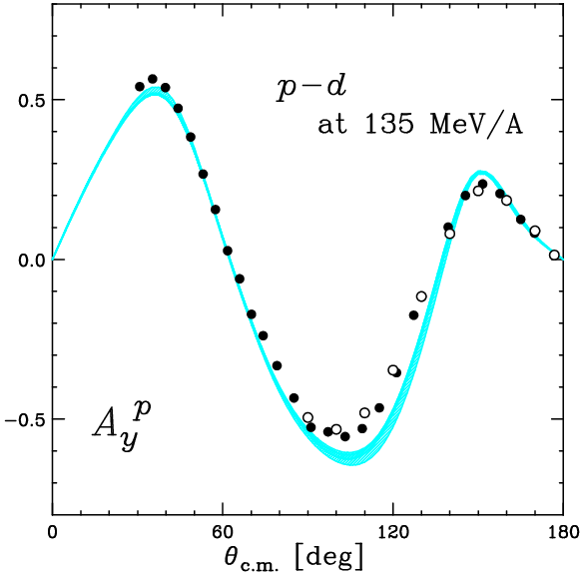
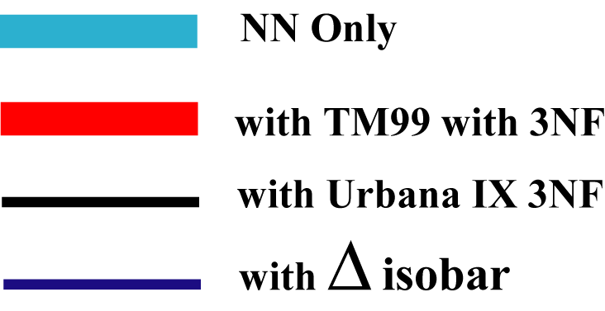
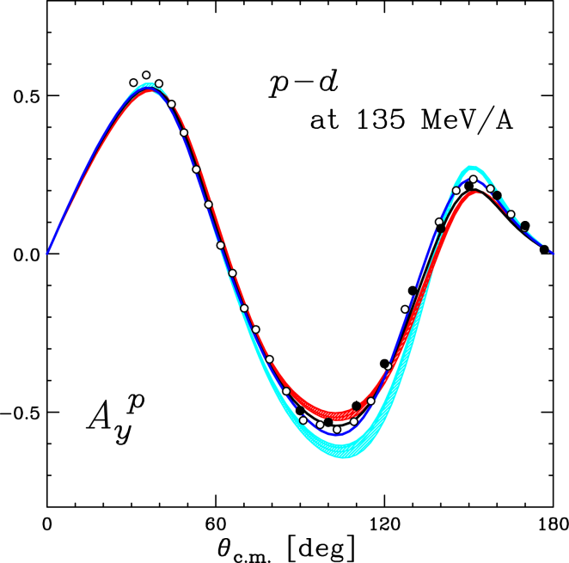
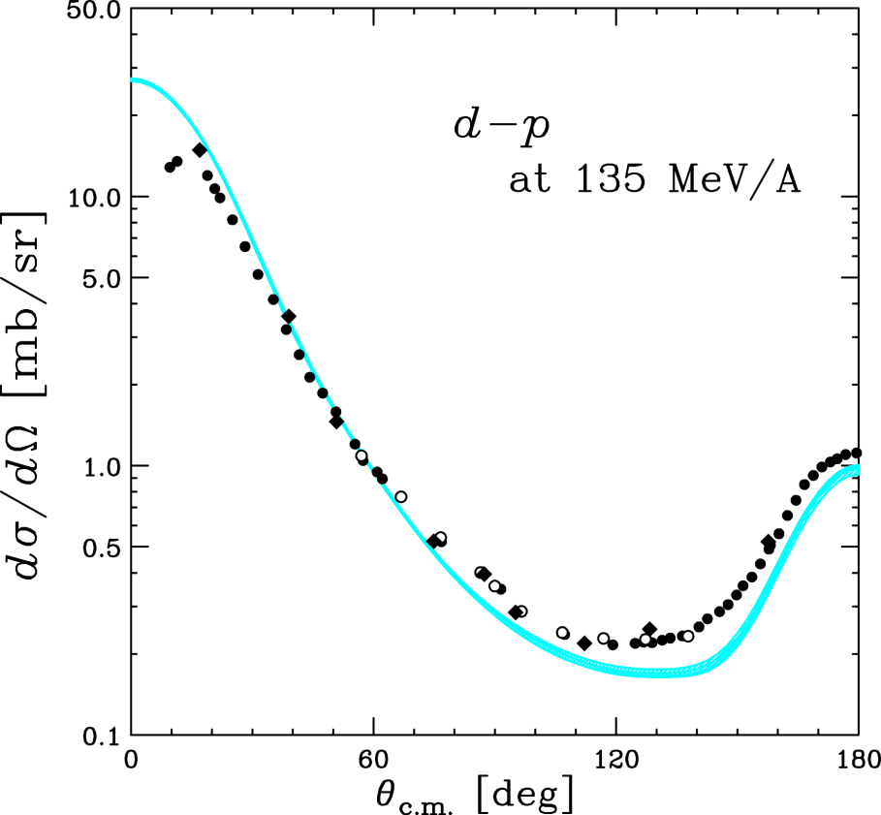
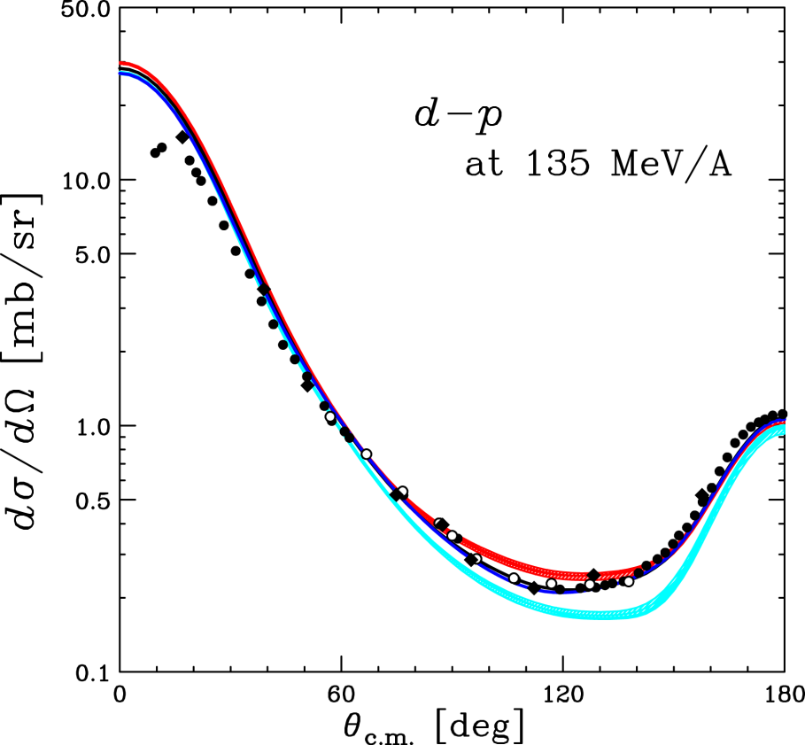
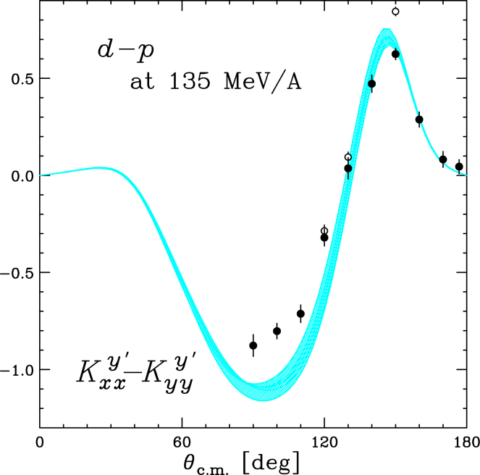
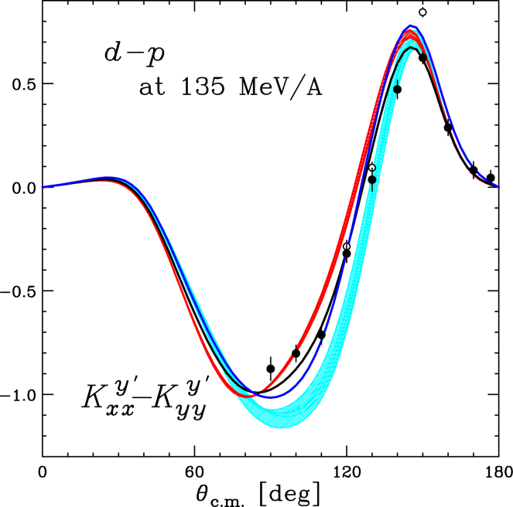
3NF Effects in p-d Scattering at 135 MeV/A
K. S. et al. PRC 65, 034003(2002); PRC 70, 014001(2004)
K.Sekiguchi et al.,PRC 65,034003(2002).
NN Only → Unsuccessful at
cross section minima
with TM99 3NF
with UIX 3NF
Successful
with Δ-isobar

Slide 7
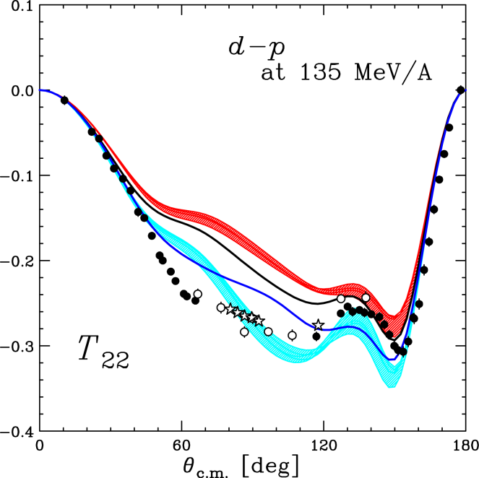
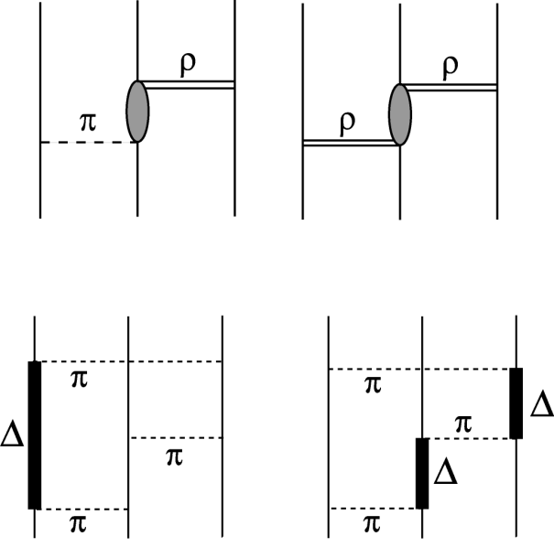
Defects in Spin Dependent Part of 3NF
Tensor analyzing power T₂₂
Possibility for better description
  New 3NF
    π-ρ and ρ-ρ exchange 3NF
    Many Δ contributions with π-ring
  Relativistic effects
    Limited at very backward angles
      H.Witala et al., PRC 71, 054001(2005).
  Systematic description of 3NF
    Chiral Effective Field Theory (χEFT)
NN Only → Unsuccessful at wide θ
with TM99 3NF
with UIX 3NF
NOT improve
with Δ-isobar
→Suggest defects in spin dependence
K.Sekiguchi et al.,PRC 65,034003(2002).

Slide 8
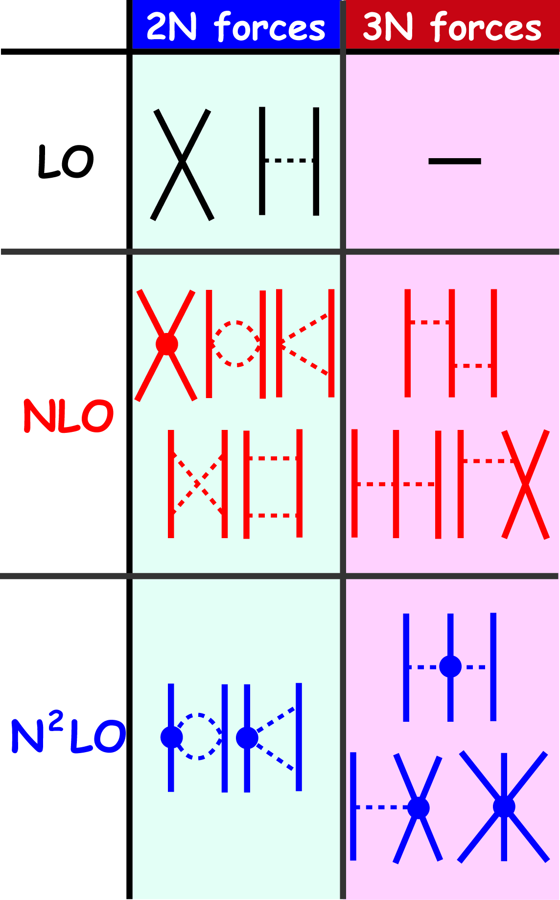
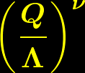
Progress in Theoretical Treatment
ーChiral effective field theoryー
E.Epelbaum, PPNP 57,654(2006).
Chiral Perturbation Theory
  Systematic description of
  strong interactions
  at low energies
ν=0
=0 at
non-rel.
limit
ν=2
π+N
Δ + Heavy-meson
FM-type
3NF
expansion
ν=3
→ nNF derived consistently

Slide 9
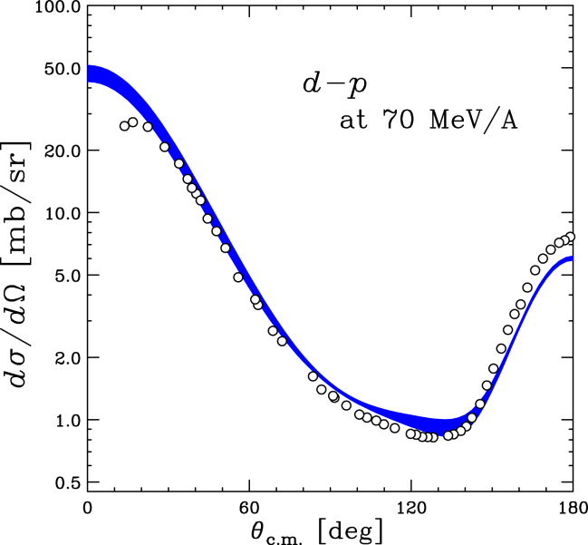
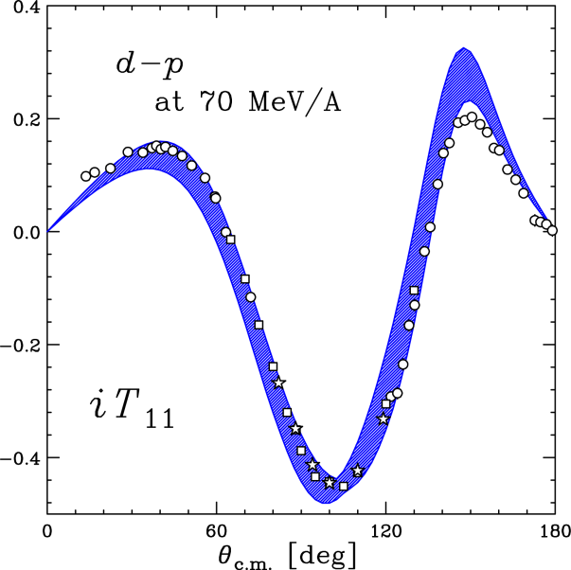
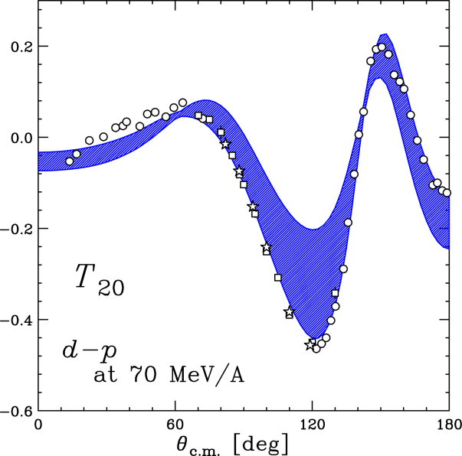
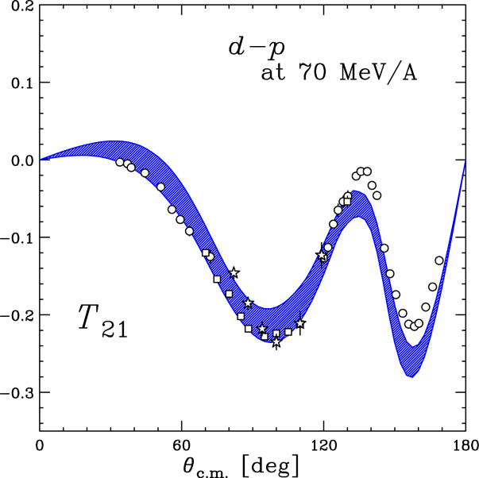
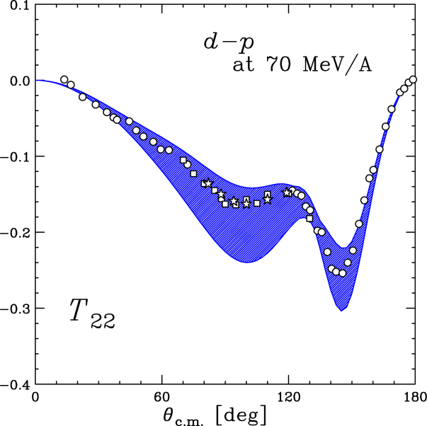
Faddeev Calc. with χEFT Potential
E.Epelbaum, PPNP 57,654(2006).
E.Epelbaum et al., PRC 66,064001(2002).
χEFT can be applied up to 100 MeV/A
Reasonable reproduction of data within theoretical uncertainty (Λ choice)
d-p at 70 MeV/A
Calc. with χEFT Pot. (NNLO)
by E. Epelbaum et al.

Slide 10
Extensions of 3NF Study
³He(p,n)3p
  Form 3p(T=3/2) system
      d+p → T=1/2 only
  Existence of 3p resonance
  → Signature of T=3/2 3NF
    NO 3N resonance
    in Faddeev calc. with NN only
      H.Witala and W.Glockle, PRC 60,024002(1999)
      A.Hemmdan, W.Glockle, and H.Kamada, PRC 66,054001(2002)
d+p → p+p+n [d+p breakup]
  Many kinematic config.
  Check 3NF models
d+p → d+p at higher energies [d+p elastic]
  Relativistic effects
d+p → ³He+γ [d+p radiative capture]
  Expected to be sensitive for short-range 3NF
3p resonance(?)
FSI
Kalantar (KVI)
In parallel session
(Spin in Nuclei I)

Slide 11
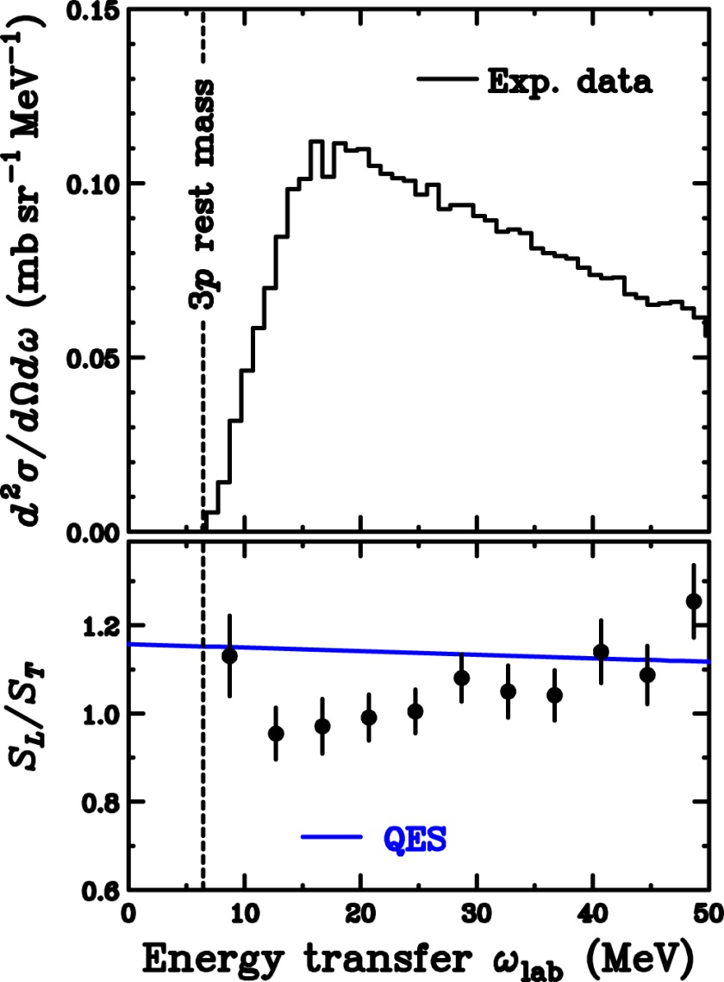
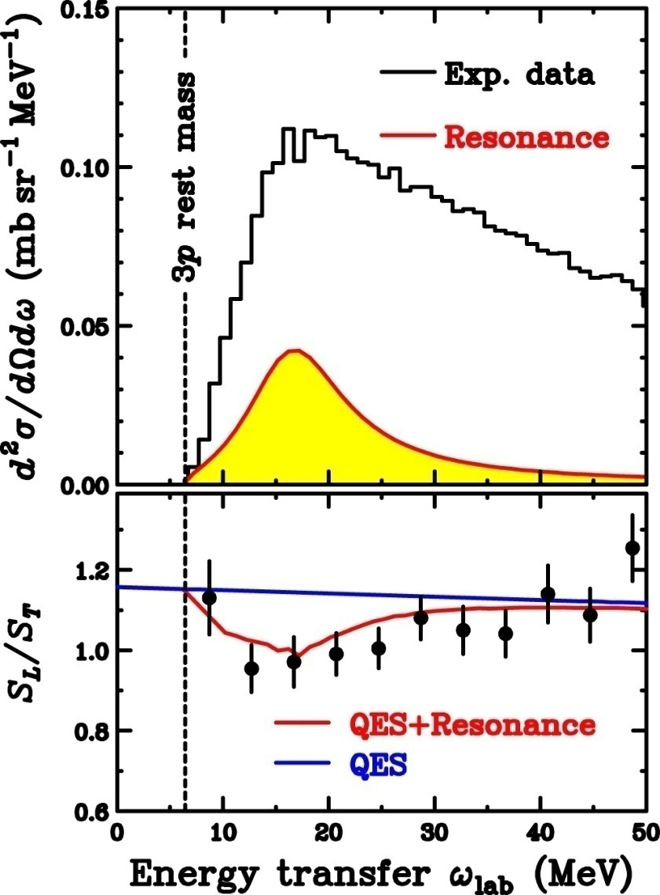
Search for 3-Nucleon T=3/2 Resonance
Production of 3p(T=3/2) system
  ³He(p,n)3p at 346 MeV and 0°
  Large physical B.G. from QES
    Non-resonant n-knockout from ³He
    →Free NN scatt.
Spin-flip probabilities
  Longitudinal S_{L}
  Transverse S_{T}
  S_{L}/S_{T} < QES (non-resonance)
Sensitivity of S_{L}/S_{T} for J^{π}
Reproduce exp. S_{L}/S_{T} with (1/2)⁻
E.Ihara, T.W., et al.,
PRC 78, 024607(2008).
J^{π} | S_{L}/S_{T}
(1/2)⁻ | 0.7 < QES
(1/2)⁺ , (3/2)± | 1.3-1.6 > QES
Signature of T=3/2 3N resonance
→Challenging data for T=3/2 3NF
and 4N system

Slide 12
Pionic Correlations in
Spin and Isospin Responses

Slide 13
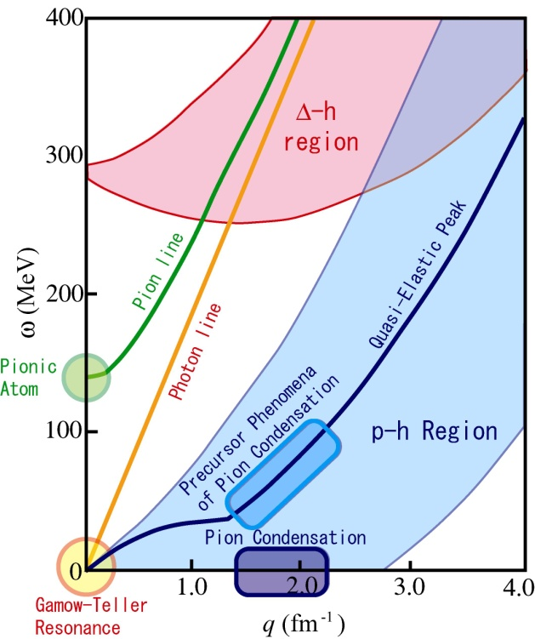
Spin-Isospin Modes in Nuclei
M.Ichimura, H.Sakai, T.W., PPNP 56(2006)446.
Spin-isospin responses have been widely studied via
  GT/M1 at q～0 and small ω
    (p,n) , (³He,t) , (p,p’)
  SDR at small q and small ω
    (p,n) , (d,²He)
  QES at large q (1-2 fm⁻¹) and medium ω
    (p,n)
  Spin-longitudinal at wide q and small ω
    (p,n), (p,p’) (Dispersion matching)
  Pionic atoms at small q and large ω (m_{π})
    (d,³He), (p,²He)
In progress
  GT at small q and medium ω
    ICHOR/SHARAQ at RIBF by U-Tokyo
Goal: Understand spin-isospin responses in wide (q,ω) in a unified way
Pionic and rho-mesonic correlations in nuclei
Tensor correlations in nuclei

Slide 14
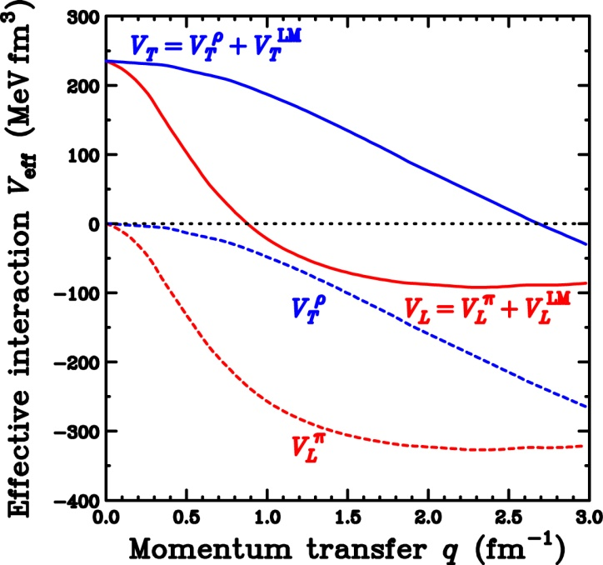



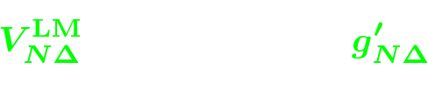
Nuclear Correlations and Δ Effects
Effective Interaction
π+ρ+g’ model
  Spin-longitudinal
  Spin-transverse
NN(p-h) effective Interaction
Extension to N+Δ system for LM interaction
Longitudinal (π)
Transverse (ρ)
π-exchange
Short-range repulsion
ρ-exchange
2-free parameters: g’_{NN} and g’_{NΔ}

Slide 15
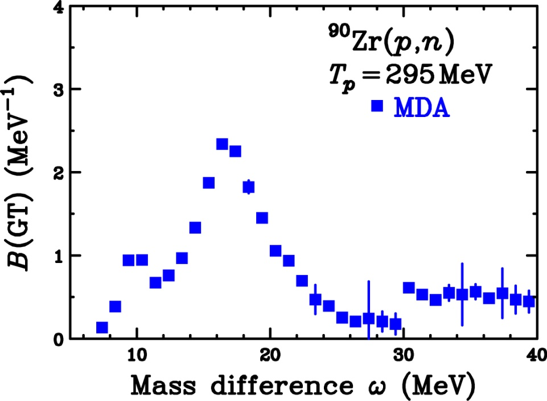
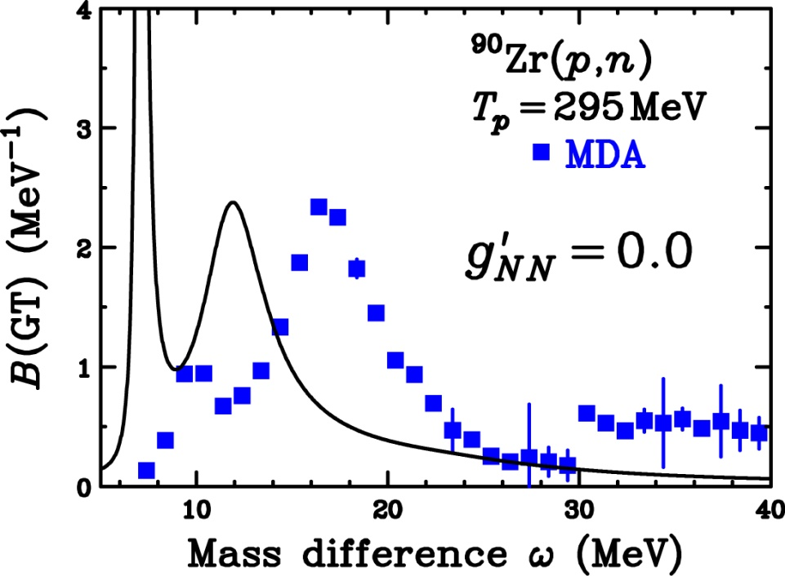
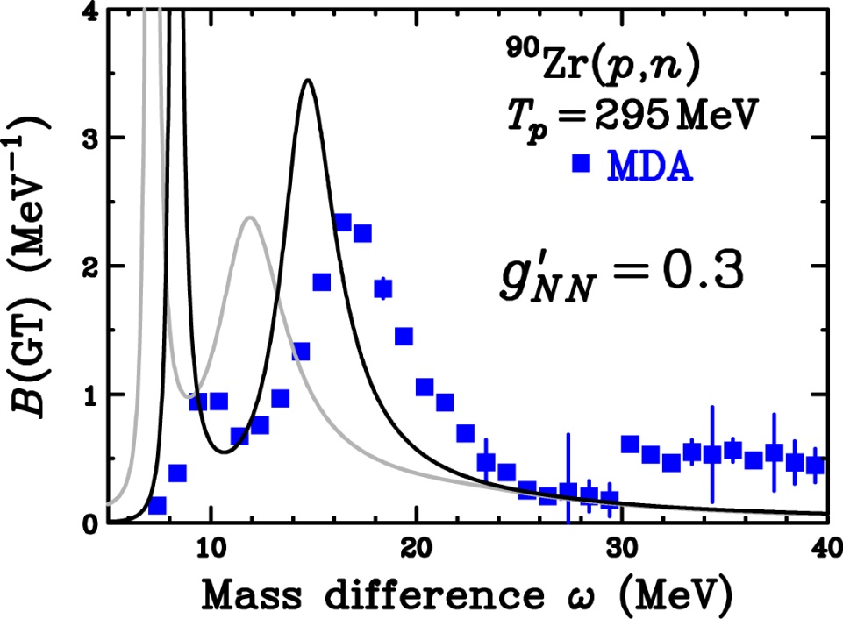
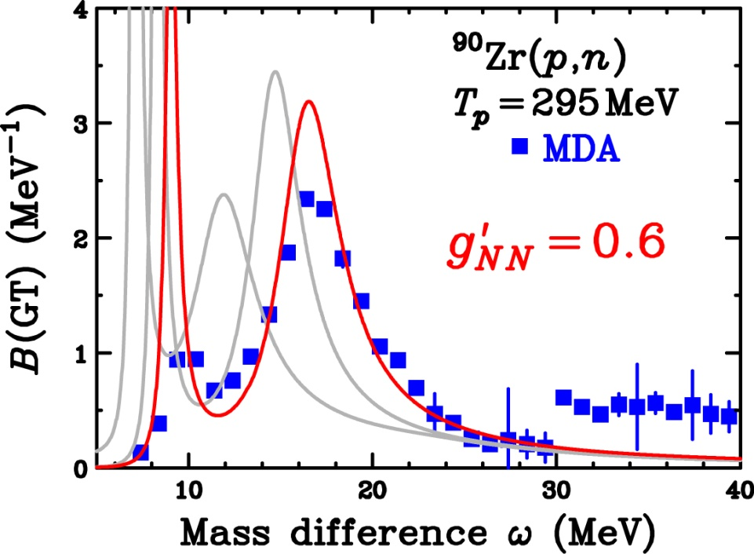
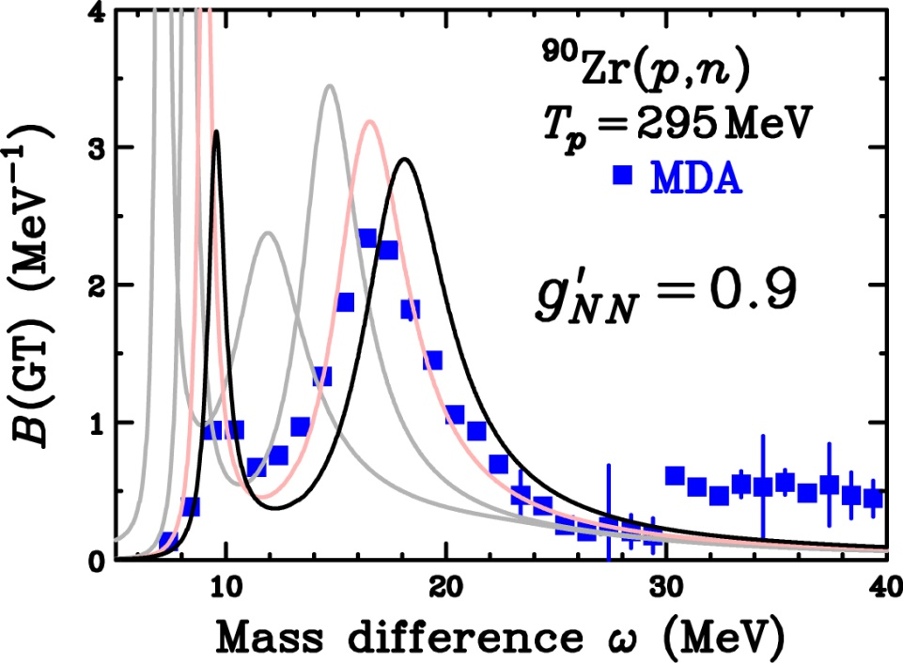

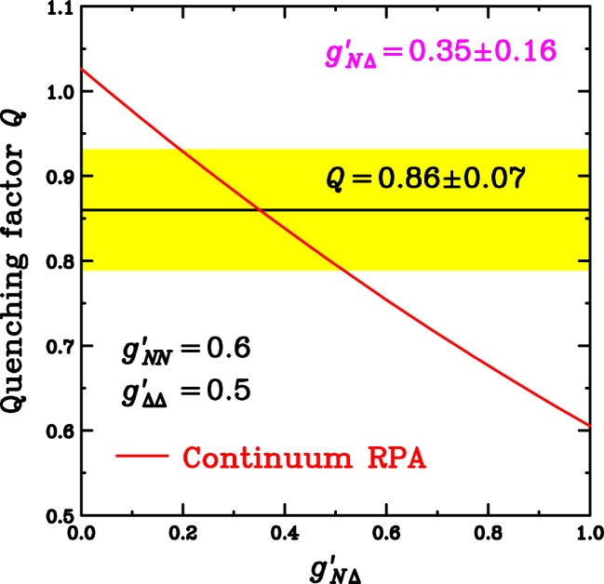

GT Strength and Landau-Migdal Parameters
K.Yako et al., PLB 615(2005)193.
T.W. et al., PRC 72(2005)067303.
g’ dependence on GTGR
  RPA(1p1h) by Ichimura group
  GTGR peak position
    Strongly depends on g’ _{NN}
    Weak g’_{NΔ} dependence
g’_{NΔ} dependence on GT quenching Q
  Q=0.86±0.07 (quadratic sum of errors)
  Q evaluated in RPA
    Strongly depends on g’_{NΔ}
Notes:
Since we obtained the precise distribution of the GT strength and the quenching factor Q, we can determine the Landau-Migdal parameters with these results.
This figure shows the GT beta- strength distribution.
We would like to compare with the RPA calculations with different Landau-Migdal parameter g’NN.
For example, the calculation with g’NN=0 becomes like this.
With increasing g’NN, the peak position of the calculation shifts upward like this.
The calculation with g’NN=0.6 reproduces the exprimental data very well.
If we take g’NN=0.9, then GTGR peak position becomes too high.
Next we change the Landau-Migdal parameter g’ND which specify the coupling between nucleon and Delta.
With increasing g’ND, peak height of the GTGR becomes low, but the positions are almost constant.
Thus from the GTGR peak position, we can determine the g’NN as 0.6 with an uncertainty of about 0.1.
The decrease of the peak height in changing g’ND is due to the GT quenching induced by the coupling between ph and Delta-hole states.
Therefore the g’ND can be determined from the quenching factor Q because this Q is a good measure for the coupling between ph and D-hole states.
The lower figure shows the RPA prediction for the quenching factor Q as a function of g’ND.
With our experimental data of 0.86 +/- 0.07, the g’ND can be determined as 0.35 +/- 0.16.
Please note that the g’ND is significantly smaller than the g’NN, and thus the so-called universality for the Landau-Migdal parameters does not hold.

Slide 16
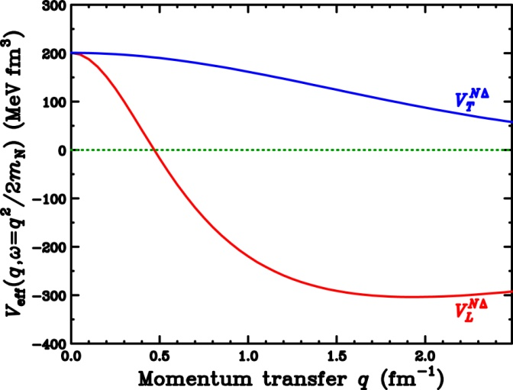
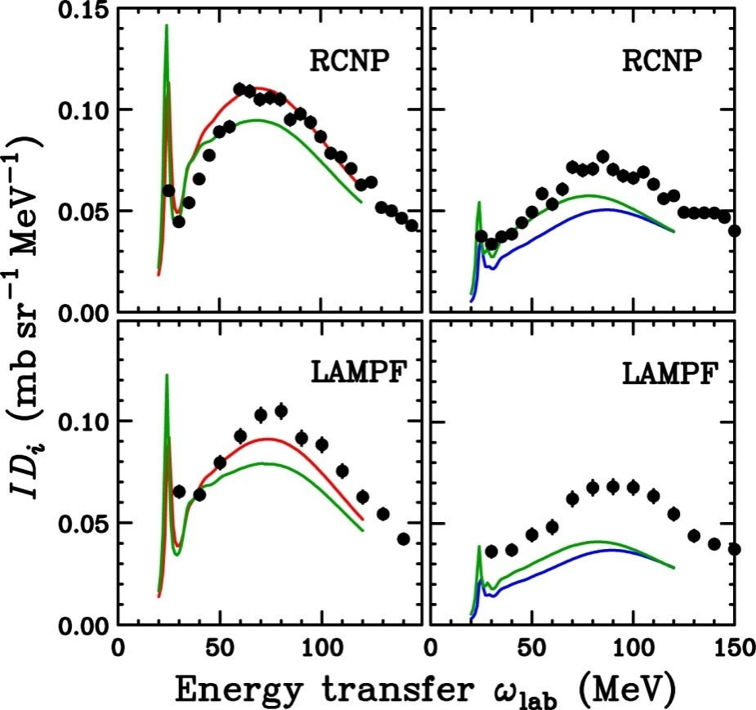
Pionic Enhancement in QES
Effective interaction at large q
  Attractive spin-longitudinal V_{L}
    Especially for NΔ with small g’_{NΔ}
Quasi-elastic scattering at large q
  Spin-longitudinal (π) mode
    Enhancement by attractive π-corr.
  Spin-transverse (ρ) mode
    Quenching by repulsive ρ-corr.
RCNP/LAMPF data on ¹²C
at q=1.7fm⁻¹
  Spin-longitudinal mode
    Exp. = RPA > Free (w/o corr.)
  Spin-transverse mode
    Exp. > Free > RPA
Spin-longitudinal
Spin-transverse
Pionic enhancement/correlations in nuclei
Attractive rho-mesonic correlations?
T.N.Taddeucci et al., PRL 73,3516(1994).
T.W. et al., PRC 59,3177(1999).

Slide 17
New Experiments for Pionic Correlations
Results of quasi-elastic scattering
    Enhancement of spin-longitudinal OK
    Quenching of spin-transverse NG
  Is Enhancement really due to attractive pionic correlations ?
    Spin-longitudinal/transverse modes were separated with D_{ij}
    Simple reaction mechanism was assumed
    More systematic data desired
New experiments at RCNP
  Measure σ of ¹⁶O(p,p’)¹⁶O(0⁻,T=1) … RCNP-E155
    Pure spin-longitudinal mode → Separation with D_{ij} is not required
  Measure D_{ij} of ¹²C(p,n)¹²N(1⁺,T=1) … RCNP-E256
    q=0～2.0 fm⁻¹
    Separation to spin-longitudinal/transverse modes
    can be checked by q-dependence

Slide 18
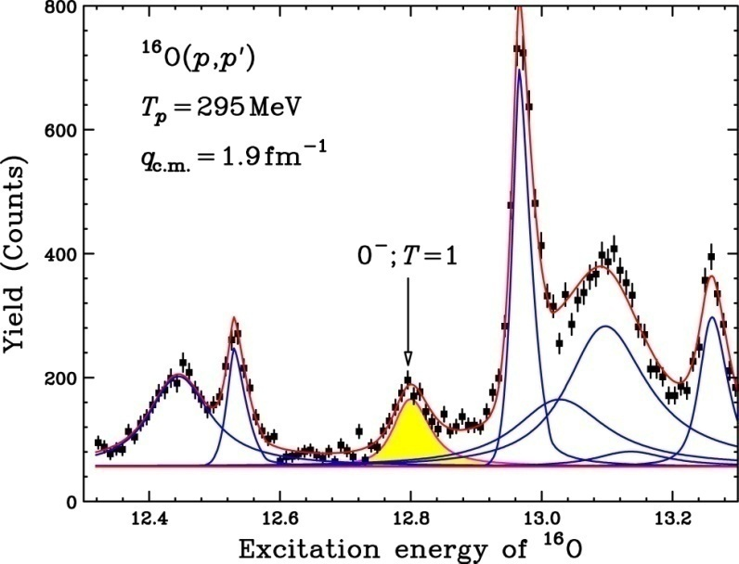
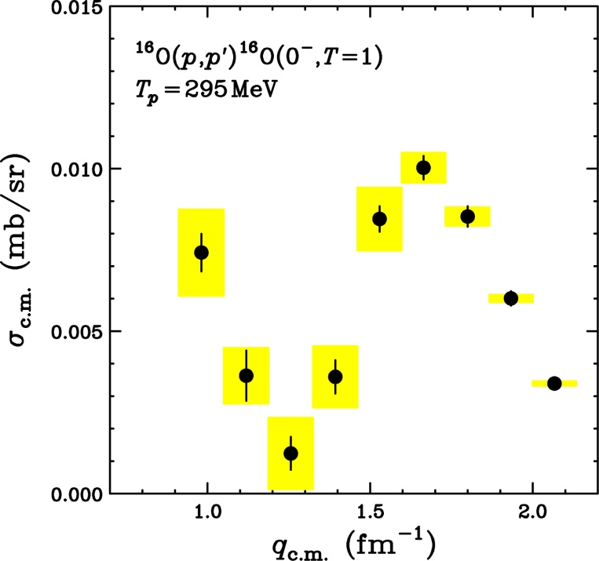
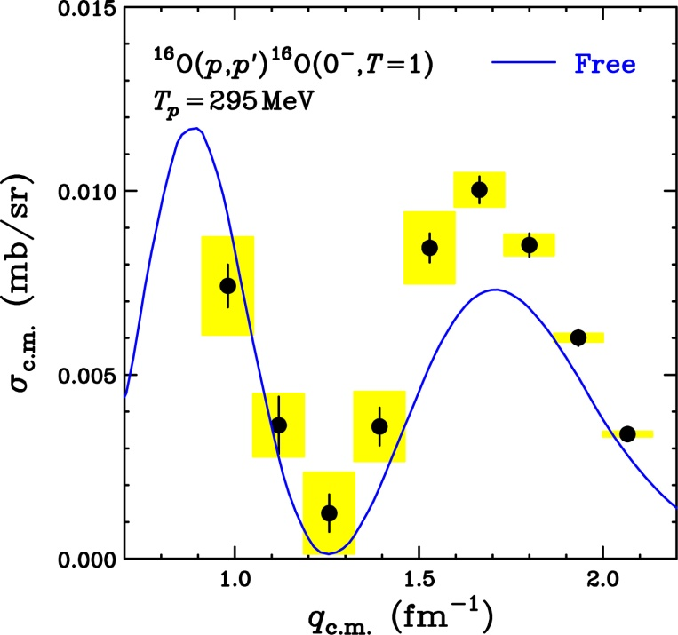
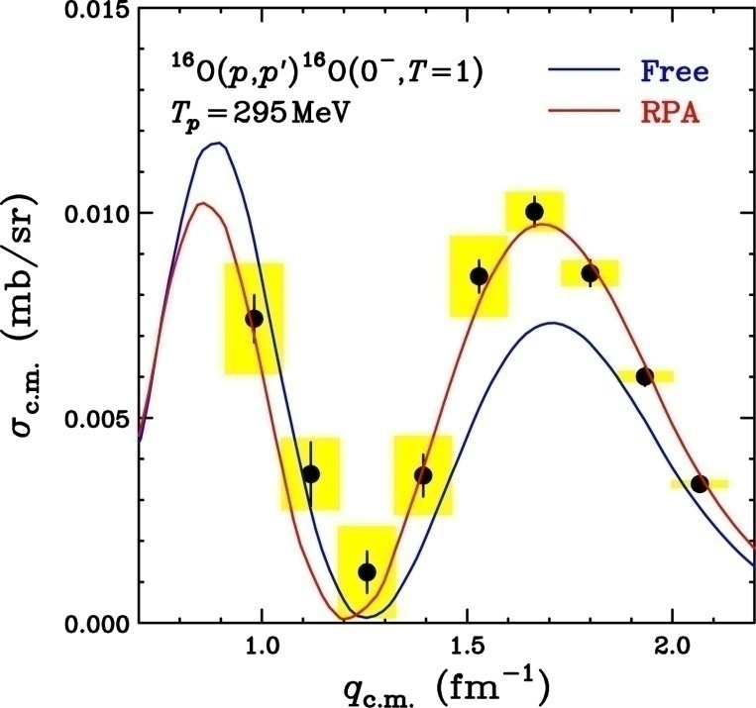
Pionic Enhancement in ¹⁶O(p,p’)¹⁶O(0⁻,T=1)
T.W. et al., PLB 632(2007)485.
Isovector J^{π}=0⁻ excitations
  Carry π-like quantum number
  Pure information on pionic mode
Experiment: ¹⁶O(p,p’)¹⁶O(0⁻,T=1)
  ΔE=30 keV with WS+GR
  q_{c.m.} = 0.9 – 2.1 fm⁻¹
Comparison with Theory
  － Without correlation (Free)
    Significant enhancement
  － With RPA correlation
    g’s are the same as those in QES
      Parameter-free calculations
    Predict the enhancement of
    the 3rd peak (q=1.7fm⁻¹)
100 keV
The data supports pionic enhancement
Signature of precursor for pion
condensation in pure pionic mode

Slide 19
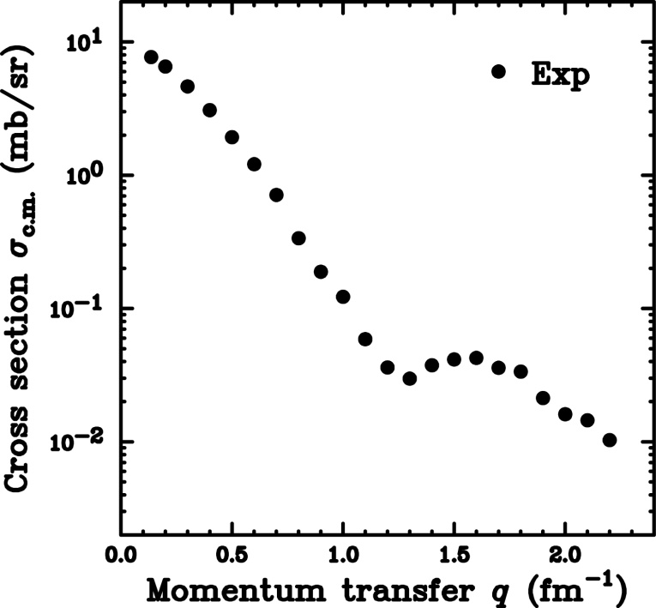
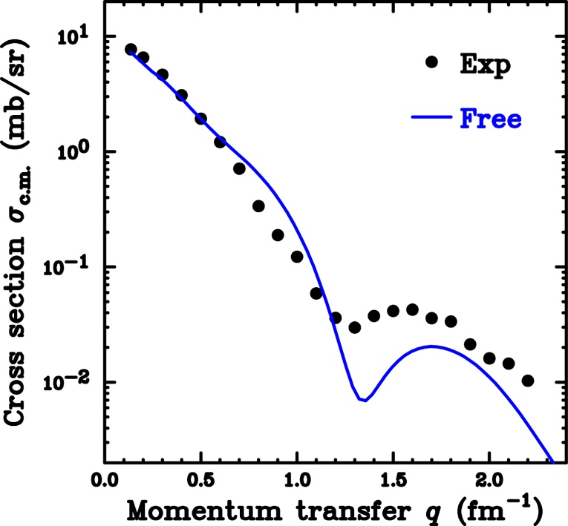
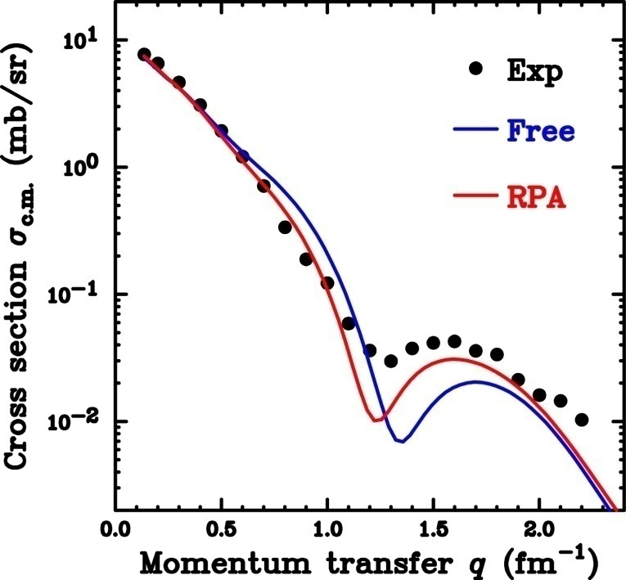
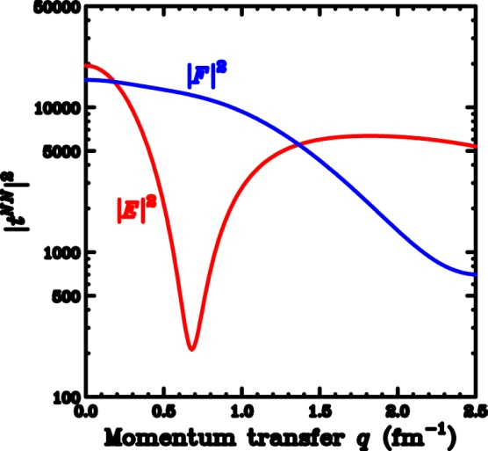
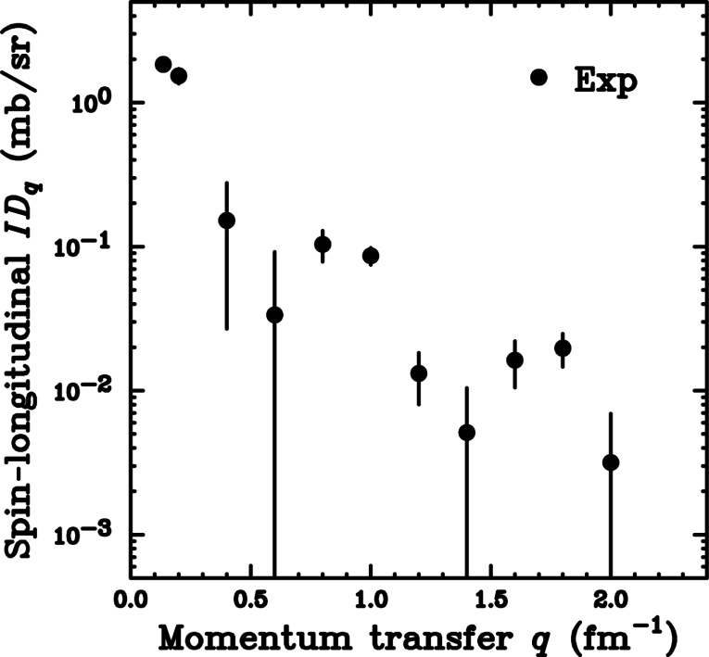
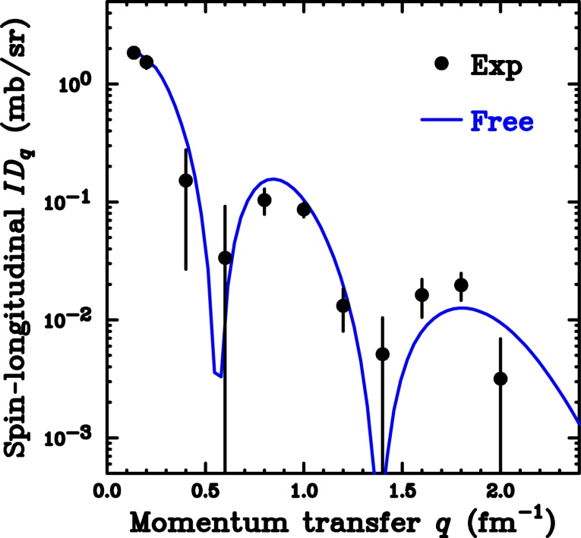
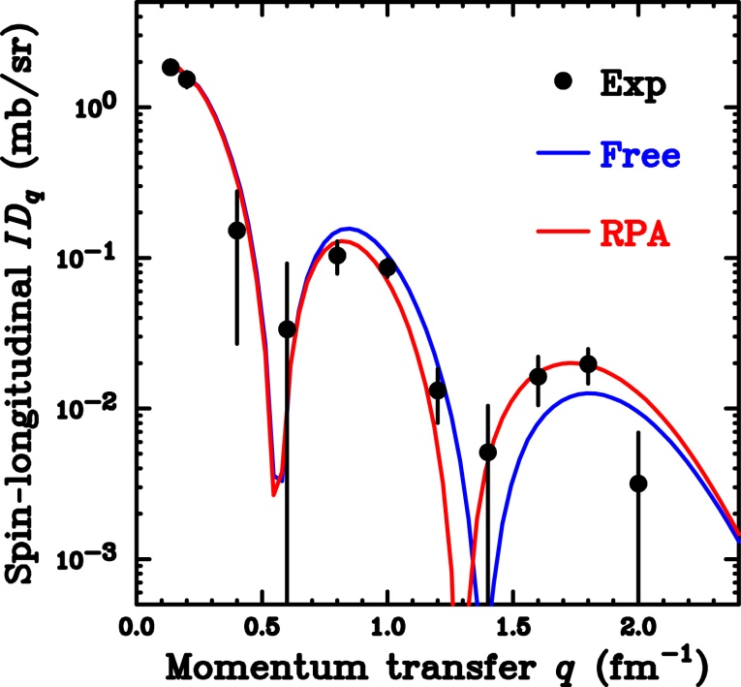
Pionic Enhancement in ¹²C(p,n)¹²N(1⁺,T=1)
M.Dozono, T.W., et al.,
PLB 656(2007)38.
Polarized cross section
  ID_{q} = KN |E|² R_{q}
  ID_{p} = KN |F|² R_{p}
Comparison with Free
  Significant enhancement
Comparison with RPA
  g’s are the same as
  those in QES
    Parameter-free
  Predict
  enhancement of
  the 3rd peak
Extract
Spin-longitudinal (π)
with PTO
Separation of π/ρ-mode
with PTO is reliable
ρ-mode
π-mode
This data ALSO supports
pionic enhancement
⇒ What about ρ-mode?

Slide 20
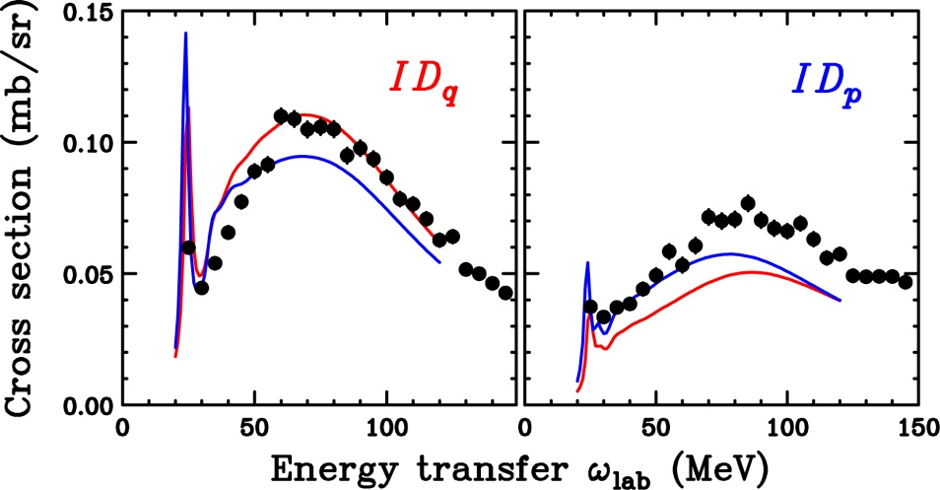
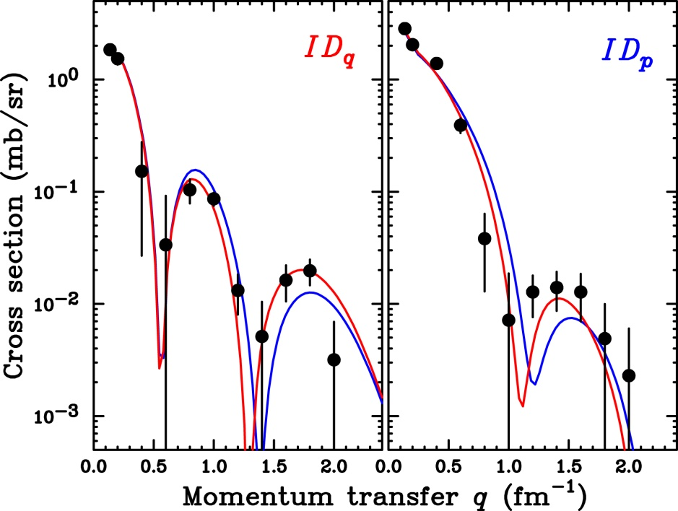
Nuclear Correlations in ¹²C(p,n)¹²N(1⁺)
Theoretical prediction
  Blue : w/o correlations
  Red : w/ correlations
    B(GT) is normalized at q=0
    → g’ effects have been excluded
    for the GT case
π-mode
  At large q
    Exp. = RPA > Free(w/o corr.)
ρ-mode
  At large q
    Exp. > RPA > Free(w/o corr.)
π-mode
ρ-mode
QES(q=1.7fm⁻¹)
Attractive π-corr. at large q
Gamow-Teller
Suggest attractive ρ-corr. at large q
Spin-transverse in (e,e’) ?
Systematic understanding ?

Slide 21
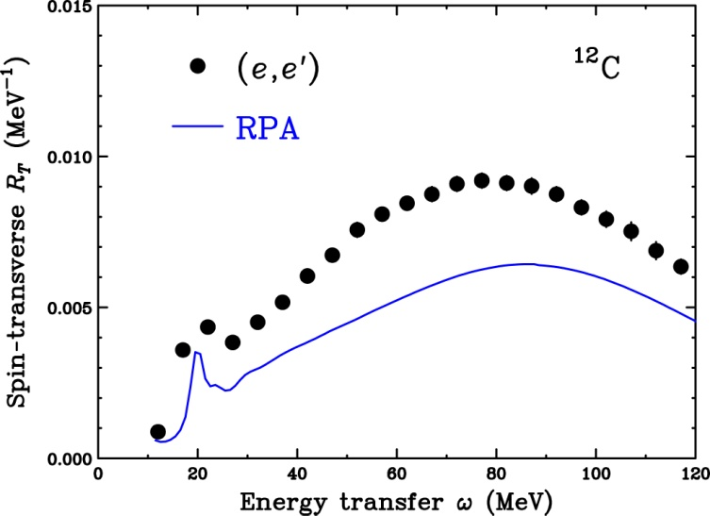

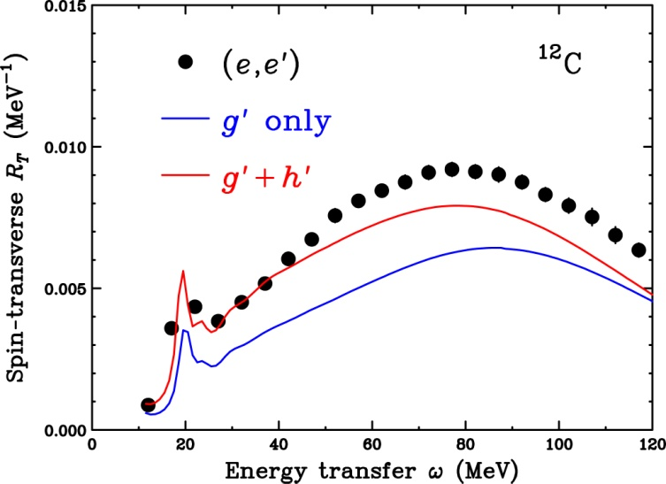


Short-Range Tensor Correlations
Spin-transverse (e,e’) response
  Enhancement from RPA
    Higher-order (2p2h) effects
    MEC
Different g’ for π and ρ-modes
Short-range tensor h’
  h’ effects are limited at large q
  h’ effects are attractive for ρ-mode
Longitudinal (π)
Transverse (ρ)
Central
Short-range tensor
Spin-Longitudinal (π)
Spin-Transverse ( ρ)
Reasonably reproduce (e,e’) response
with short-range tensor h’
(Under-estimation at large ω would be 2p2h effets)
C.J.Horowitz et al., PRC 50,2540(1994).
M.Ichimura et al.,PPNP 56,446(2006).

Slide 22
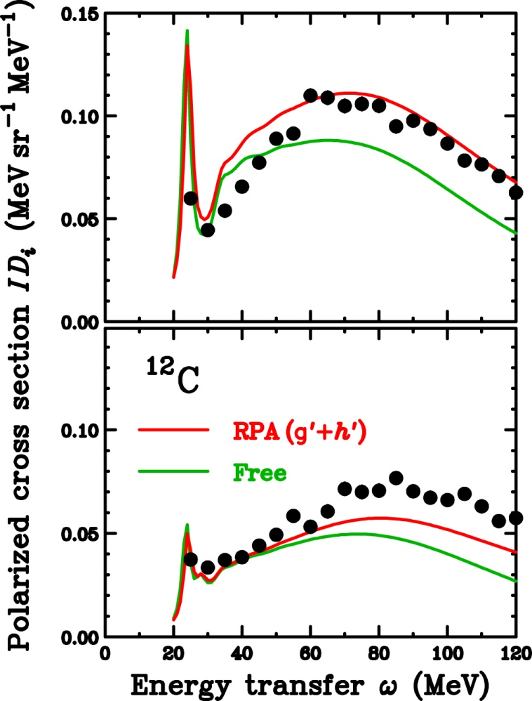
DWIA with Short-Range Tensor Correlations
Short-range tensor h’
  Determined by (e,e’) response
    Include Higher-order (2p2h)
  Parameter-free calc.
Spin-longitudinal (π) mode
  g’ values are adjusted within errors
    g’_{NN}=0.6→0.5
    g’_{NΔ}=0.35→0.2
Spin-transverse (ρ) mode
Spin-longitudinal (π)
π + g’ (less repulsive)+ h’(repulsive)
→ Net attractive effects for π-mode
→ Enhancement of π-mode
Spin-transverse (ρ)
ρ +g’(less repulsive) + h’(attractive)
→ Repulsive effects by g’ are cancelled by h’
→ Weak enhancement of ρ-mode
Short-range tensor correlations can provide better description for QES at large q
Discrepancy at large ω (Higher-order effects not included by h’?)
h’ treatment for higher-order effects is reasonable ?

Slide 23
Gamow-Teller and
Spin-Dipole Strengths

Slide 24
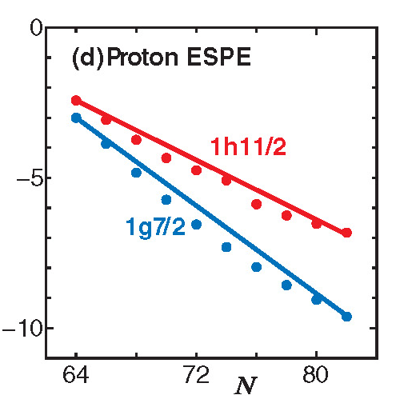

Tensor Force Effects in Nuclei
T.Otsuka et al.,PRL 95,232502(2005).
Proton s.p. Energy of Sb
Tensor force
  NN int. is originally due to meson exchange
  Tensor force is a manifestation of
  meson exchange
Shell-structure due to tensor force
  Due to tensor correlations,
  excess neutrons (j>)
    Pull-up proton-orbit with j>
    Pull-down proton-orbit with j<
  Experimental data for Sb
  are well reproduced
Tensor force effects on SD
  Attractive effects for J^{π}=0⁻,2⁻
  Repulsive effects for J^{π}=1⁻
J<
Energy (MeV)
J<
Neutron
w/o tensor
w/ tensor
Fragmentation
Softening
1⁻ strengths are fragmented
0⁻ strength is concentrated at 9 MeV

Slide 25





Experimental Study of SDR in ¹²B
Tensor effects depend on J^{π}
  Selectivity is required
  Tensor analyzing power A_{zz} of (d,²He)
First measurement at RIKEN
  0⁻ is identified at 9.3 MeV
  SDR at 7 MeV is mainly 2⁻
Later High-res. Measurement at KVI
  Confirm 0⁻ at 9.3 MeV
  Lower-part of SDR at 7 MeV is 2⁻
  Upper-part of SDR at 7 MeV is 1⁻
RIKEN data
KVI data
ΔE=130 KeV
1⁻
2⁻
0⁻
2⁻
0⁻
Consistent with calc. employing tensor forces
0⁻ was identified at 9.3 MeV
1⁻ seems to be weak (fragmented)
→ Systematic data and calc. desired
M.A. de Huu et al., PLB 649,35(2007).
H.Okamura et al., PRC 66,054602(2002).

Slide 26


0ν2β Decay and Nuclear Matrix Element
F.Simkovic et al.,PRC 77,045503(2008).
If 0ν2β decay is observed
  Neutrino: Majorana particle (ν=ν)
  Neutrino has finite mass
    ABSOLUTE value of mass
Relation between T_{1/2} and m_{ν}
  M^{0ν} information from nuclear physics
  is very important
Accuracy of M^{0ν}
  0⁺ → 1⁺ (GT) → 0⁺
    Sensitive to parameter in theory
  0⁺ → 1⁻, 2⁻ (SDR) → 0⁺
    Dominant component
1⁺
“+” Parity
Phase space, etc
Effective mass
Param. dep.
1⁻
“-” Parity
0ν2β exp.
Nuclear matrix (theory)
2⁻
¹⁰⁰Mo(0⁺)
→¹⁰⁰Tc(J±)
→¹⁰⁰Rc(0⁺)
“Experimental” GT and SDR strengths in 2β-decay nuclei
→ Constraint to “theory” would improve accuracy of M^{0ν}

Slide 27
Intermediate GT Strength in ⁴⁸Sc
ー ⁴⁸Ca → ⁴⁸Sc → ⁴⁸Ti ー
courtesy of K.Yako
Measure ⁴⁸Ca(p,n) and ⁴⁸Ti(n,p)
  Multipole decomposition analysis
    Extract GT-1⁺(L=0)
  L=0 strength up to 30 MeV
Exp. vs. Theor. GT strength
  Reasonable description for β⁻
  Missing for β⁺ at E_{x} > 10 MeV
  (In part, IVSM)
Important information for refining 2β-decay matrix element
β⁻ : ⁴⁸Ca →⁴⁸Sc
Exp.
Theory
Preliminary
β⁺ : ⁴⁸Sc →⁴⁸Ti
Preliminary
Shell model calc.
Horoi et al.,PRC 75,034303(2007).

Slide 28

Separation of SDR into Each J^{π}
Separation of SDR(L=1) into 0⁻,1⁻,2⁻ is important
  The SDR contribution to M^{0ν} is largest
    Contributions depend on J^{π}
  Tensor effects depend on J^{π}
“Normal” multipole decomposition
  Separate into each L component
    Works very well to extract GT(L=0)
  Could not separate into J^{π} with same L
    Angular distributions are governed by L
Idea to separate SDR into each J^{π}
  Polarization observables are sensitive to J^{π}
  Separate c.s. into longitudinal (π)-transverse (ρ)
    0⁻ : spin-longitudinal (π) only
    1⁻ : spin-transverse (ρ) only
    2⁻ : Both
DWIA for ¹²C(p,n)
Spin-longitudinal (π)
Spin-transverse (ρ)
Easy to separate
Ｍultipole decomposition for spin-longitudinal (π) and transverse (ρ) c.s.
→ Can separate/specify not only L, BUT ALSO J^{π}

Slide 29

Challenge to Separate SDR into Each J^{π}
Apply the new method to ¹²C(p,n)
  High resolution ¹²C(d,²He) data are available
    Can check the reliability
  J^{π} for SDR at 7 MeV is still controversial
    Information on tensor correlations
Preliminary results (with partial data)
  Proper assignments for known states
    GT at 0.0 MeV → 1⁺
    SDR at 4 MeV → 2⁻
  Identification of 0⁻
    Strength at 8 MeV → 0⁻
  Decomposition of SDR at 7 MeV
    Lower-energy side : 2⁻
    Higher-energy side : 1⁻
Consistent with high res. ¹²C(d,²He)
  J^{π} decomposition seems to be reliable
M.Dozono et al.,
RCNP-E317
VERY PRELIMINARY
Spin-longitudinal (π)
Spin-transverse (ρ)
1⁺
2⁻
2⁻
2⁻
1⁻
2⁻
0⁻
Much more detailed analysis required,
But seems to be applicable to 2β-decay nuclei

Slide 30
Summary and Outlook
Three nucleon force effects in few nucleon systems
  Data is accumulating
    3NF effects are clear
    Defects in spin-dependent part of 3NF → Short-range 3NF
  Theoretical development
    Coulomb and Relativistic effects → Important but limited
    New formalism, e.g. χEFT → Systematic understanding
Pionic correlations in spin and isospin responses
  Signature of pionic enhancements as a precursor of π- cond.
    Quasi-elastic Scatt., ¹⁶O(p,p’)¹⁶O(0⁻,T=1), ¹²C(p,n)¹²N(1⁺,T=1)
    Unified understanding in π+ρ+g’ employing short-range tensor
Gamow-Teller and Spin-Dipole Strengths
  Strengths can be experimentally extracted via MDA
  Spin-parity can ALSO be separated
    Tensor forces → Important and should be considered
    2β-decay matrix element

Slide 31




RI Beam Factory at RIKEN
p target @ 100K and 0.1
C₁₀H₈
by T.Wakui
A.Sakaguchi
Few-body reaction
with polarized d beam
@ 200-440 MeV/A
Polarimeter
SHARAQ spectrometer
operational
in 2009
by K.Sekiguchi
δp/p = 15000 with dispersion match
exothermic (Q > 0) reaction ⇒ q = 0
with RI-beam @ 300 MeV/A
by S.Shimoura
T.Uesaka

Slide 32
Acknowledgement
Thanks to all collaborators involved with relevant experiments, in particular to
  K. Yako (University of Tokyo)
  K. Sekiguchi (RIKEN Nishina Center)
  Y. Maeda (Miyazaki University)
  M. Dozono (Kyushu University)
  E. Ihara (Kyushu University)
  for valuable comments and figure preparation.
Thank you for your attention

Slide 33
Backup

Slide 34



Progress in Theoretical Treatment
ーCoulomb Interactionー
Failure at small θ
  Coulomb int. effects
  Inherently lacking
  in Faddeev calc.
Coulomb int. can be included
  Screening+Renomalization
Coulomb interaction
  Significant at small θ
  Reproduce the data well
Faddeev calc. with Coulomb int.
Faddeev calc. w/o Coulomb int.
NN + 3NF
NN + 3NF
NN only
NN only
At Intermediate energies,
Coulomb interaction effects
are limited at very forward angles
A.Deltuva et al.,PRC 68,024005(2003).
A.Deltuva et al., PRC 71,054005(2005).

Slide 35
Extensions of 3NF Study
³He(p,n)3p
  Form 3p(T=3/2) system
      d+p → T=1/2 only
  Existence of 3p resonance
  → Signature of T=3/2 3NF
    NO 3N resonance
    in Faddeev calc. with NN only
d+p → p+p+n [d+p breakup]
  Many kinematic config.
  Check 3NF models
d+p → d+p at higher energies [d+p elastic]
  Relativistic effects
d+p → ³He+γ [d+p radiative capture]
  Expected to be sensitive for short-range 3NF
3p resonance(?)
FSI

Slide 36







d-p breakup
courtesy of K.Sekiguchi
3NF successful
Urbana IX is better
No 3NF
2NF only
2NF + TM99-3NF
2NF + Urbana IX-3NF
3NF effects in d-p breakup
  A_{xx}: BETTER description of the data
  K_{yy}^{y’} : BETTER description by Urbana IX (NOT conclusive)
  A_{y} : WORSE description of the data
  → Challenging data for refining 3NF (short-range 3NF etc.)

Slide 37


Gamow-Teller and Spin-Dipole Strengths
²⁰⁸Pb(p,n) at 295 MeV
Gross Features of GT and SD strength
  Reasonably reproduced
    DWIA+RPA with π+ρ+g’
    HF+RPA with Skyrme Int.
    Quasi-particle RPA
    …
Detailed information is ALSO important
  2β-decay nuclear matrix elements
  Tensor interaction effects
0.1°
GTGR
4.0°
SDR
Recent experimental studies and efforts
To extract GT and SD strengths
T.W. et al., NPA 599,217c(1996).
RCNP-E57.

Slide 38






Neutron Skin Thickness and SD Sum Rule
H.Sagawa et al.,PRC 76,024301(2007).
Neutron-skin thickness δ_{np}
  Relate to physics on nuclear matter
  δ_{np} has linear correlation with
    Symmetry energy
    EOS of neutron matter
Proton and neutron distributions
  Fundamental properties
    Proton r.m.s. → Well known
    Neutron r.m.s. → Poorly known
SD sum rule and δ_{np} (Model Independent)
SkI3
Proton r.m.s
Neutron r.m.s
δ_{np} (fm)
SIII
SGII
Pressure at ρ=0.1 fm³ (MeV)
(p,n)
(n,p)
deduced
e-scattering

Slide 39



Multipole Decomposition and SD Sum Rule
K.Yako et al.,PRC 74,051303(R)(2006).
MD analysis for ⁹⁰Zr(p,n) and (n,p)
  Deduce ΔL=1 cross section
  (p,n) at 4.6°
      SDR at 20 MeV
  (n,p) at 4°ー 5°
      ΔL=1 at E_{x}<10 MeV
SD strength
  Use proportionality relation
    L=1 c.s. ∝ SD strength
  Proportionality coefficient is
  determined by DWIA
Integrated SD strengths
  S₋ = 247 ± 4(stat.) ± 12 (MD)
  S₊ = 98 ± 4(stat.) ± 5(MD)
SDR
SD
Only 1% rel. error

Slide 40
Neutron Skin Thickness and EOS
K.Yako et al.,PRC 74,051303(R)(2006).
H.Sagawa et al.,PRC 76,024301(2007).
δ_{np} from SD sum rule
  Model independent
  Consistent with predictions
Neutron-matter EOS
  Constrain to EOS → Difficult !!
Comparison with other model-dependent studies
SkI3
δ_{np} (fm)
SIII
SGII
Pressure at ρ=0.1 fm³ (MeV)
Method | δ_{np} (fm) | Reference
SD sum rule | 0.07 ± 0.04 | This work, PRC 74,051303R(2006).
Proton elastic scatt. | 0.09 ± 0.07 | Ray, PRC 18,1756(1978).
Antiprotonic X-ray | 0.09 ± 0.02 | Trzcinska, PRC 67, 054605 (2003).
δ_{np} from SD sum rule is consistent with other results (model-dependent)
δ_{np} for ²⁰⁸Pb could constrain to EOS → Experimental challenge

